Slide 1

Correlation
Geog4300/6300
Jerry Shannon

Slide 2
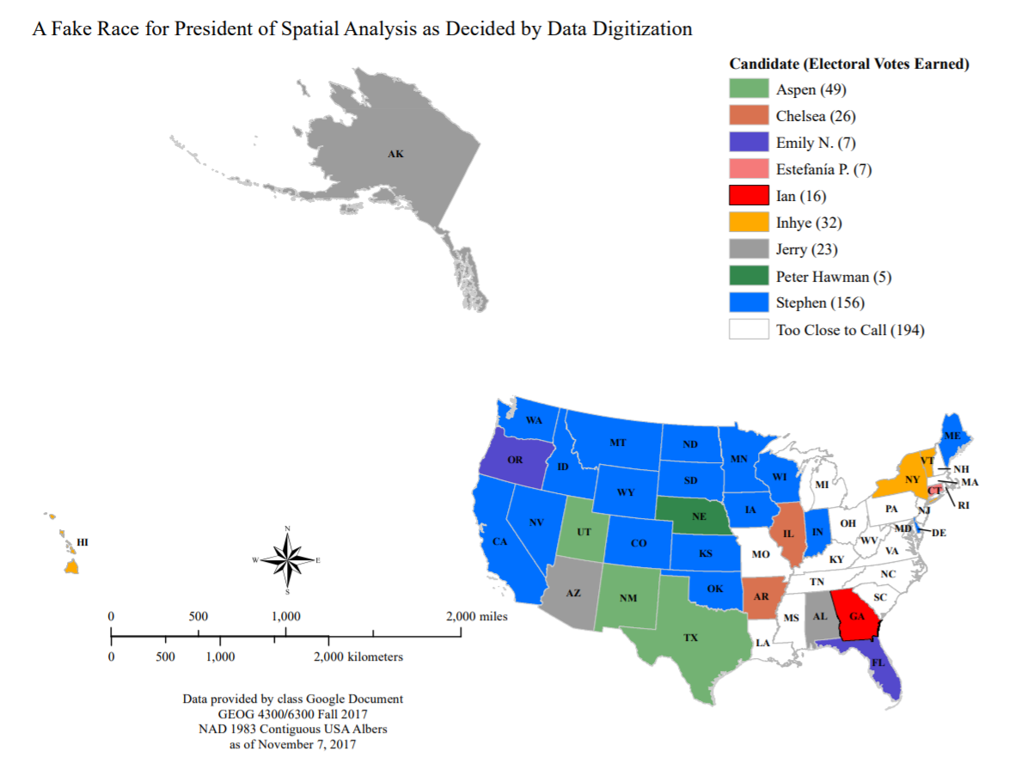

Slide 3
Variablesc | Tests; test statistics; SE
Continuous; one sample: σ known and n > 30 OR data is a proportion | One-sample z-test; Z; SE = σ/sqrt(n); OR Diff. of proportions
Continuous; one sample: σ unknown or n < 30 | One-sample t-test; t; SE = s/sqrt(n-1)
Continuous; two samples | Student’s t-test for difference of means
Continuous; paired samples | Paired t-test
Continuous; more than two samples | ANOVA
Discrete; two variables; counts | Chi-square, goodness of fit
Continuous; two or more variables | Correlation
Continuous; two or more variables | Regression
You are here

Slide 4
How are each of these variables related?
The population size and number of traffic lights in a given city
In locations around a power plant: distance from smokestack and concentration of pollutants
In large cities, size of house and year house was built
Note that these are all quantitative, continuous variables

Slide 5

Correlation examines the relationship between two continuous variables
“Do these variables co-vary with one another?”
Available from Zazzle!

Slide 6

Income vs. crime
County | MHI (US$) | VCR (crimes/100,000)
A | 40,000 | 45.2
B | 59,000 | 44.6
C | 61,000 | 39.2
D | 66,000 | 42.4
E | 68,000 | 37.4
F | 71,000 | 29.4
G | 78,000 | 38.1
H | 82,000 | 28.5
I | 89,000 | 21.4
J | 103,000 | 19.4
K | 104,000 | 25.1
L | 113,000 | 28.5
M | 129,000 | 22.5
N | 141,000 | 17.3
O | 156,000 | 13.5
How can we quantify whether (and to what extent) median household income and violent crime rate are correlated with each other?

Slide 7
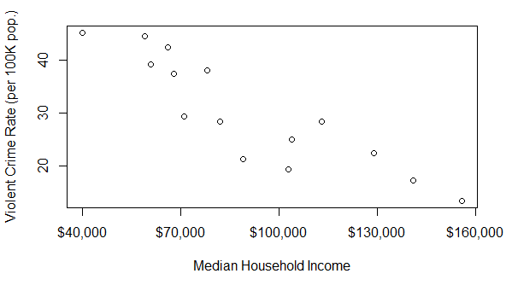
A scatterplot visualizes the relationship
County | MHI (US$) | VCR (crimes/100,000)
A | 40,000 | 45.2
B | 59,000 | 44.6
C | 61,000 | 39.2
D | 66,000 | 42.4
E | 68,000 | 37.4
F | 71,000 | 29.4
G | 78,000 | 38.1
H | 82,000 | 28.5
I | 89,000 | 21.4
J | 103,000 | 19.4
K | 104,000 | 25.1
L | 113,000 | 28.5
M | 129,000 | 22.5
N | 141,000 | 17.3
O | 156,000 | 13.5

Slide 8

This relationship is quantified using the
Pearson’s r statistic
(the correlation coefficient)
Some facts about Pearson’s r
It ranges from -1 to 1
It’s determined by how many points are in each of four quadrants of the scatter plot
It likes long walks through the countryside*
*OK, not really

Slide 9
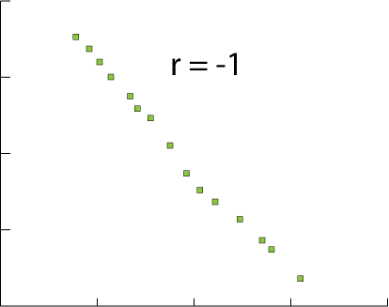
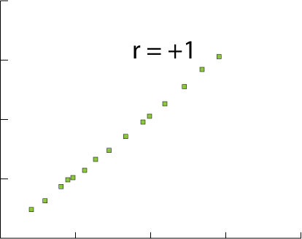
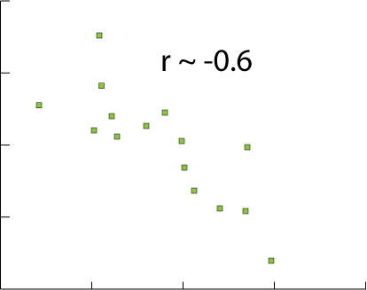
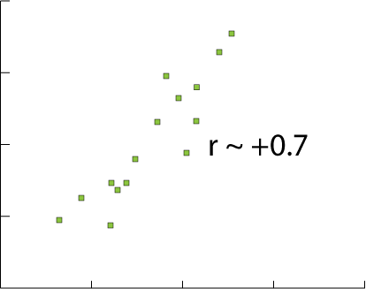
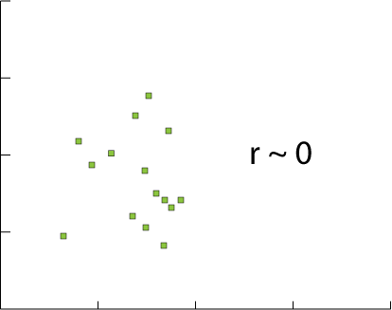
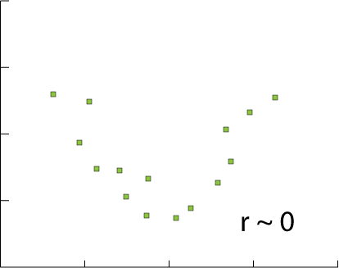
Pearson’s r and scatter plots

Slide 10
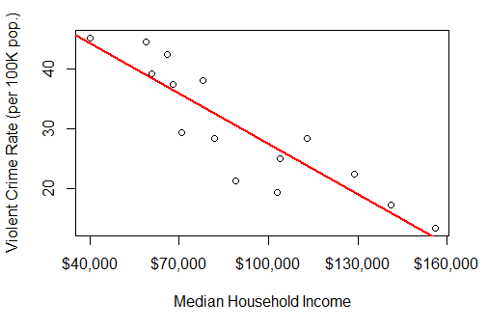
r quantifies the strength of a linear relationship
r does not explain non-linear relationships that may be obvious to our eyes

Slide 11
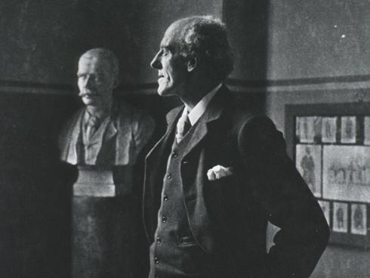
r is primarily a measure of
variance
It compares the covariance (S_{X,Y}) with the product of the each variable’s standard deviation (S_{X} and S_{Y})
“What proportion of the variances within each variable is explained by the covariance between them?”
Karl Pearson. (Unfortunately also a proponent of eugenics)

Slide 12
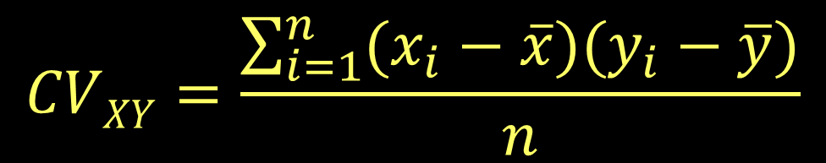
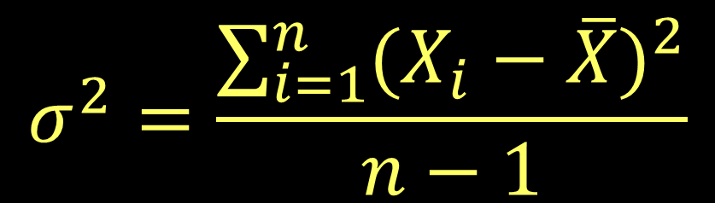
How do we measure covariance?
Multiply the difference of the two values for a given row from their respective means
This formula is similar to the variance:

Slide 13


Covariance on a scatter plot
These counties are above the average crime rate
These counties are below the average median income
and these counties are below the average crime rate
and these counties are above the average median income

Slide 14
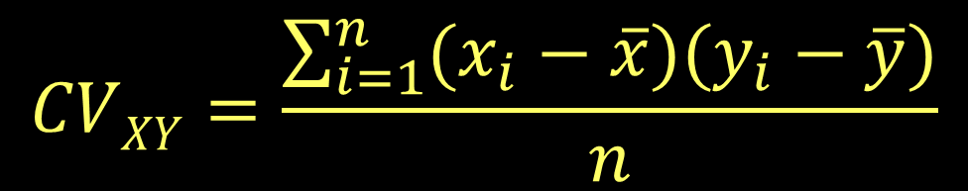





Slide 15
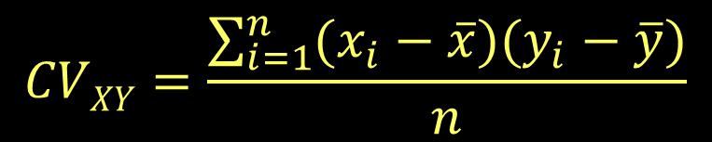
Where will covariance be positive?
#1
#2
+ / +
#3
#4
- / -

Slide 16
Where will covariance be negative?
Most of the points fall in these negative quadrants. They negatively covary.
- / +
#2
#1
#4
#3
+ / -

Slide 17
County | MHI (US$) | VCR(/100,000) | Xi - Xbar | Yi - Ybar
A | 40,000 | 45.2 | -50,667 | 15.0
B | 59,000 | 44.6 | -31,667 | 14.4
C | 61,000 | 39.2 | -29,667 | 9.0
D | 66,000 | 42.4 | -24,667 | 12.2
E | 68,000 | 37.4 | -22,667 | 7.2
F | 71,000 | 29.4 | -19,667 | -0.8
G | 78,000 | 38.1 | -12,667 | 7.9
H | 82,000 | 28.5 | -8,667 | -1.7
I | 89,000 | 21.4 | -1,667 | -8.8
J | 103,000 | 19.4 | 12,333 | -10.8
K | 104,000 | 25.1 | 13,333 | -5.1
L | 113,000 | 28.5 | 22,333 | -1.7
M | 129,000 | 22.5 | 38,333 | -7.7
N | 141,000 | 17.3 | 50,333 | -12.9
O | 156,000 | 13.5 | 65,333 | -16.7
Mean MHI: 90,667
Mean VCR: 30.2

Slide 18
County | MHI (US$) | VCR(/100,000) | Xi - Xbar | Yi - Ybar | Product
A | 40,000 | 45.2 | -50,667 | 15.0 | -760005
B | 59,000 | 44.6 | -31,667 | 14.4 | -456005
C | 61,000 | 39.2 | -29,667 | 9.0 | -267003
D | 66,000 | 42.4 | -24,667 | 12.2 | -300937
E | 68,000 | 37.4 | -22,667 | 7.2 | -163202
F | 71,000 | 29.4 | -19,667 | -0.8 | 15733.6
G | 78,000 | 38.1 | -12,667 | 7.9 | -100069
H | 82,000 | 28.5 | -8,667 | -1.7 | 14733.9
I | 89,000 | 21.4 | -1,667 | -8.8 | 14669.6
J | 103,000 | 19.4 | 12,333 | -10.8 | -133196
K | 104,000 | 25.1 | 13,333 | -5.1 | -67998.3
L | 113,000 | 28.5 | 22,333 | -1.7 | -37966.1
M | 129,000 | 22.5 | 38,333 | -7.7 | -295164
N | 141,000 | 17.3 | 50,333 | -12.9 | -649296
O | 156,000 | 13.5 | 65,333 | -16.7 | -1091061
Sum of the product column:
-4,276,767

Slide 19
-4,276,767 / 15 = 285,118

Slide 20
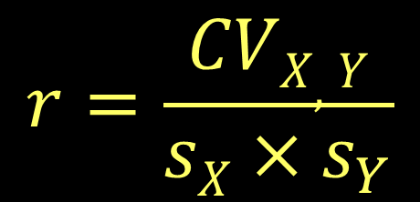
The covariance gets really big with big numbers.
(like thousands of dollars)
Solution: standardize with the product of the standard deviations.

Slide 21
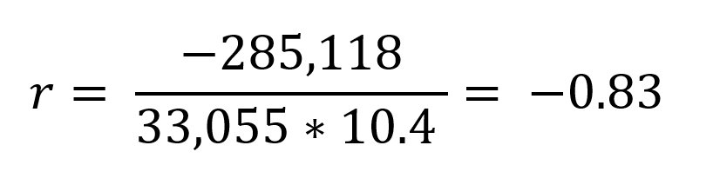
For our example:

Slide 22
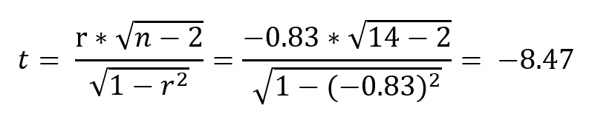

r can be converted to a t score
A significant finding!

Slide 23
Add slide on direction, magnitude, and significance

Slide 24
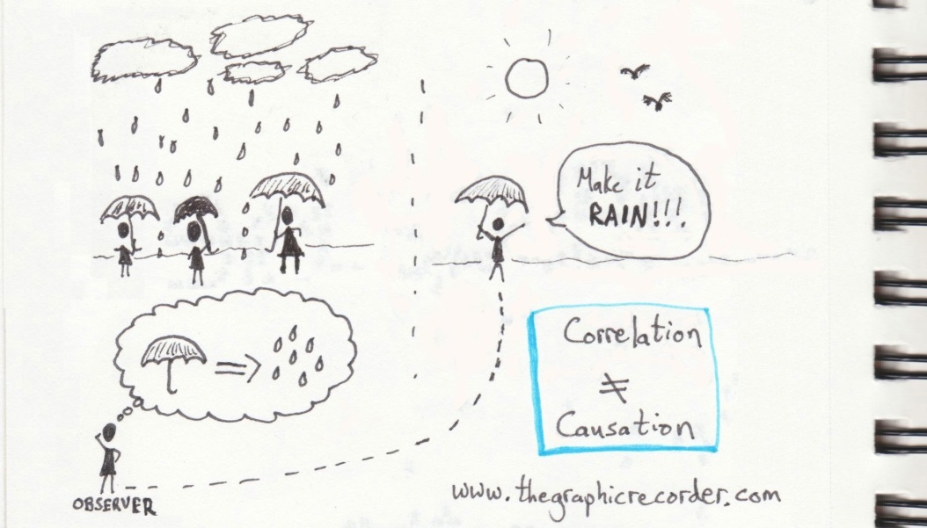
Correlation only measures covariance.
It doesn’t measure the degree to which one variable causes another to change.

Slide 25
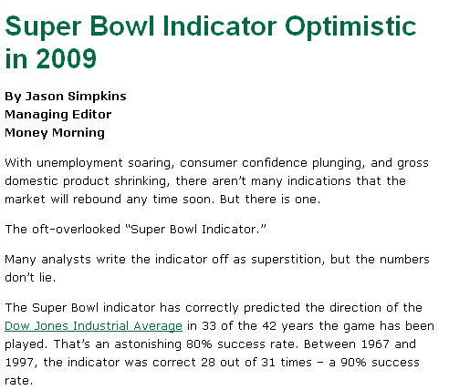
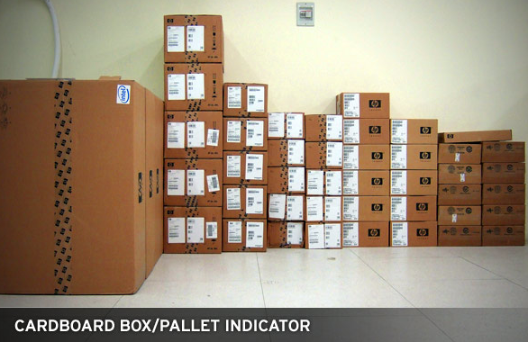
If correlation did equal causation,
we might view the world differently…

Slide 26
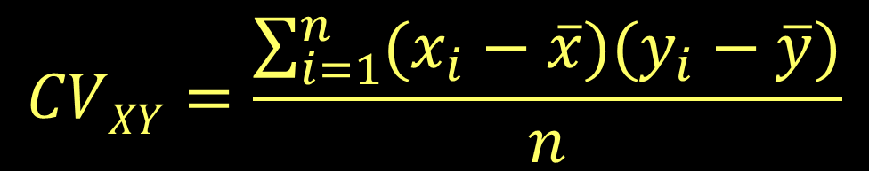
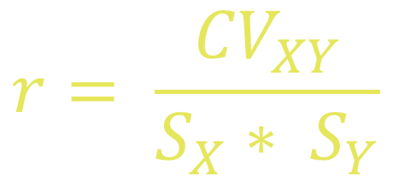
You try it!
Download the “Midwest annual pollen data” from GitHub. Using the formulas given here, calculate the r statistic for annual precipitation (precpyr) and one tree species (listed to the right of precipitation).
$$r= \frac{{CV}_{XY}}{S_{X}∗ S_{Y}}$$

Slide 27
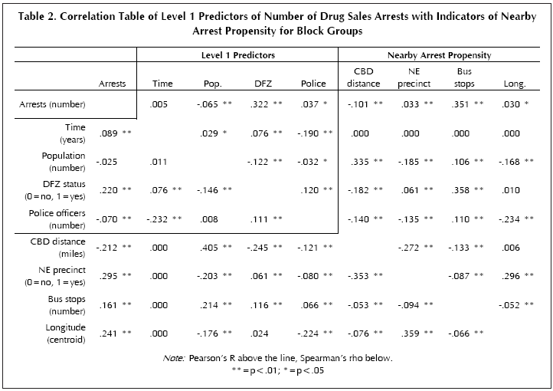
Correlation is often done with multiple variables
Robinson, Jennifer B. and Rengert, George F. "Illegal drug markets: The geographic perspective and crime propensity." Western Criminology Review 7(1): 20-32 (2006) (http://wcr.sonoma.edu/v07n1/20/sexoffender.html).

Slide 28
Wait a second…

Slide 29
What’s Spearman’s rho???

Slide 30
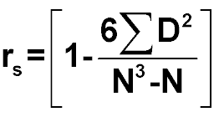
It’s the non-parametric version of correlation.
Just like Wilcoxon tests, Spearman’s rho uses ranks to calculate covariance
D=difference in ranks between x and y variables

